Slide 1
TRILHA – Arquitetura de Dados
SQL Server 2019 & Motivos para Migrar seu Banco para Cloud

Slide 2

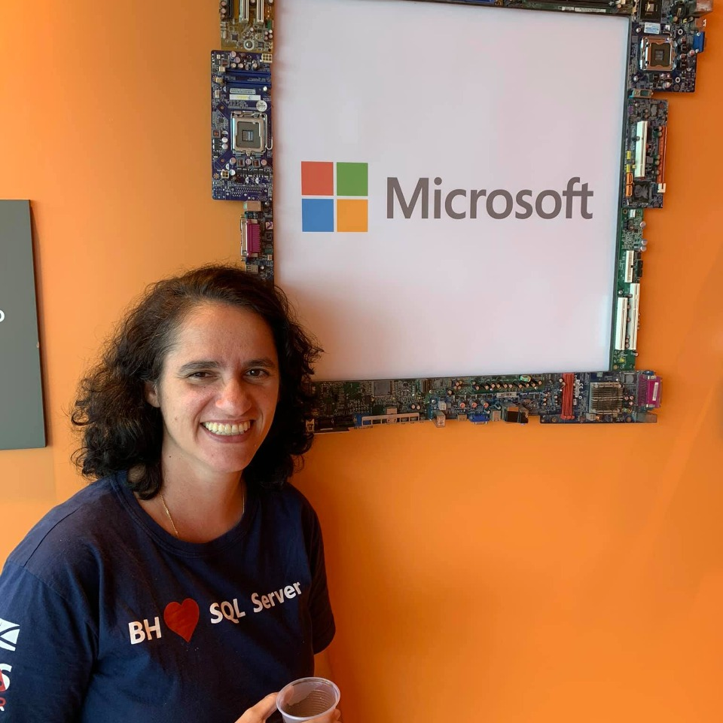
TRILHA – Arquitetura de Dados
Quem somos:
Leonardo Fonseca & Sulamita Dantas

Slide 3
SQL Server 2019
Should i migrate my SQL Server to Cloud?
Cloud Concepts
Restrictions
How to Migrate
Demo

Slide 4
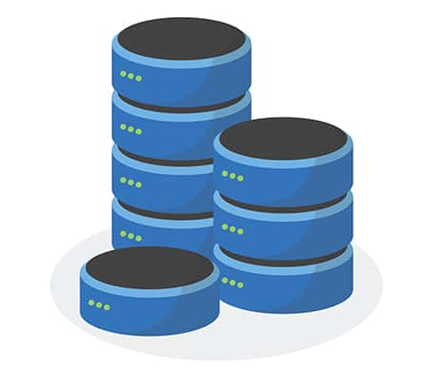
01
SQL Server 2019

Slide 5
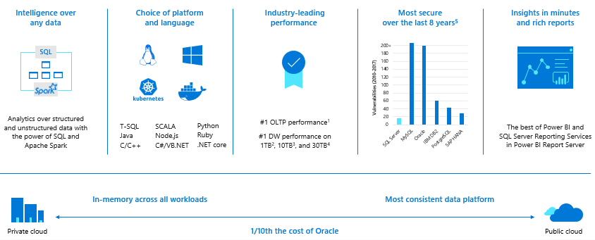

Slide 6













SQL Server 2019 solves modern data challenges
Data virtualization and Big Data Clusters
Modern platforms with compatibility
Built-in Machine Learning and extensibility
R
PolyBase
SQL
ARM64
Intelligent performance
Layers of security and compliance
Business critical high availability
Query
ciphertext
Secure Enclaves
Learn
Memory grant
In-memory
Data Classification
plaintext
Run query
Intelligent Query Processing
Accelerated Database Recovery

Slide 7
02
Should i migrate my SQL Server to Cloud?

Slide 8
I need a fast way to patch SQL
Part of my company uses Linux
Software and hardware refresh
Security
threats
I want to remove some of the management overhead and stress
Urgent capacity needs
Compliance
I want to build new apps with the highest uptime
Quickly integrate acquisitions
Application
innovation
We desire a consistent database in the company
I need to migrate to Azure quickly
Software end
of support
Datacenter contracts expiry
Migration & modernization triggers

Slide 9
03
Cloud Concepts

Slide 10
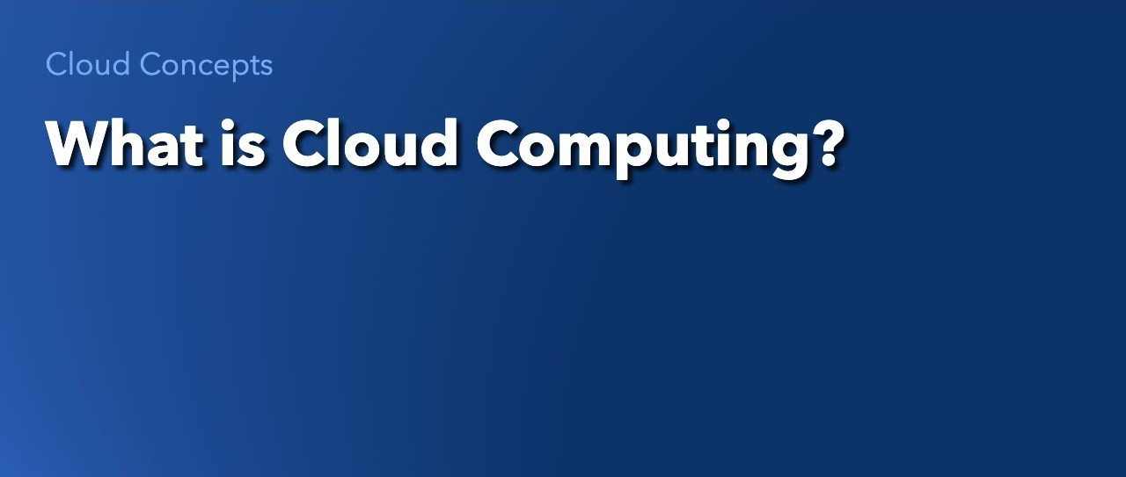

Slide 11
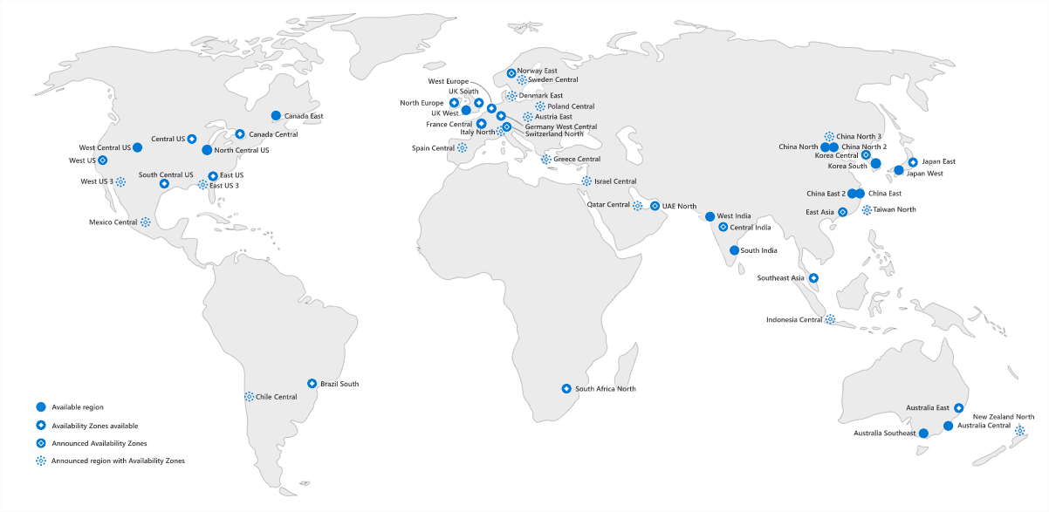

Slide 12
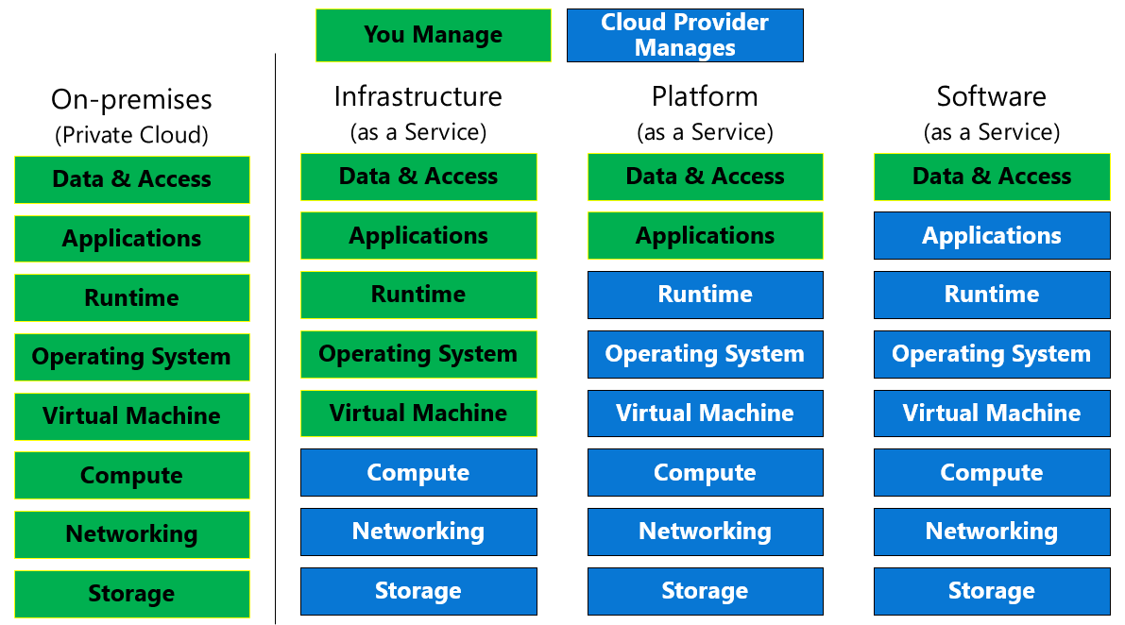

Slide 13
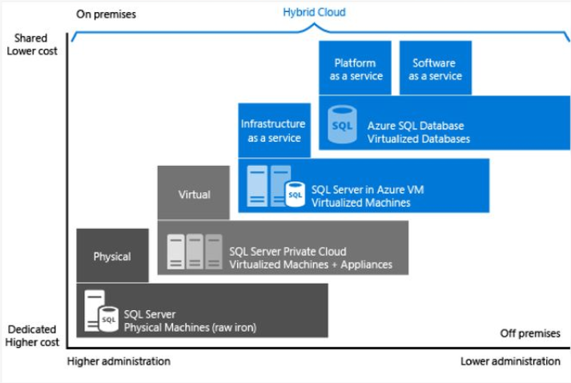

Slide 14


Slide 15
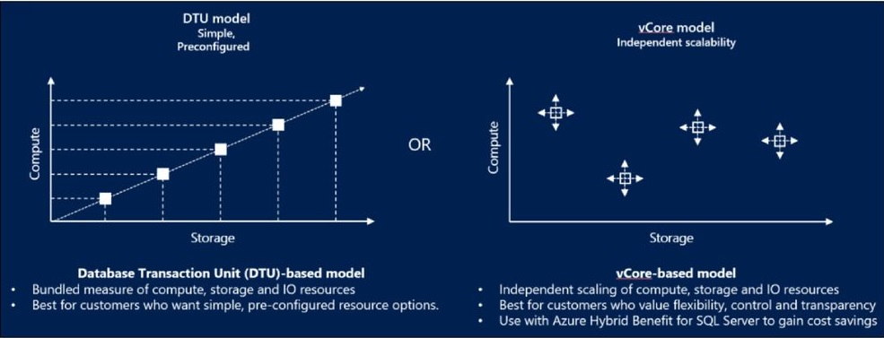
DTU vs vCore

Slide 16
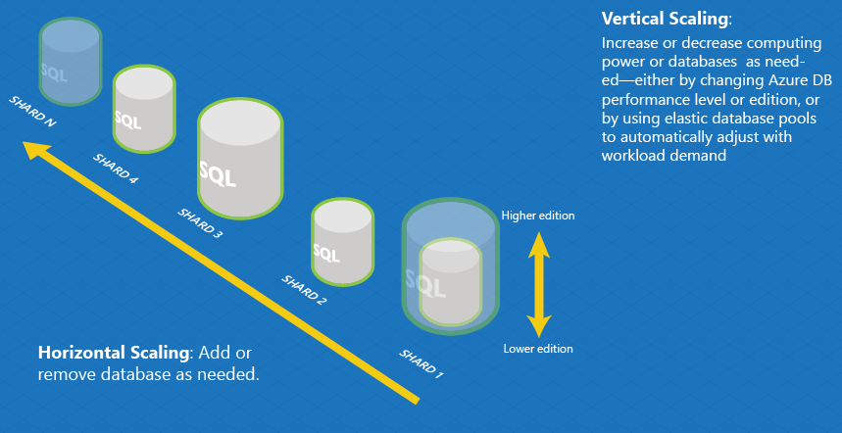
Elasticity VS Scalability

Slide 17
Service Level Agreement (SLA)
Service tier | Single zone SLA | Multiple zones SLA
Basic, Standard, General Purpose | 99.99% | N/A
Premium, Business critical | 99.99% | 99.995%
Hyperscale w/ 0 replicas | 99.5% | N/A
Hyperscale w/ 1 replica | 99.9% | N/A
Hyperscale w/ 2+ replica | 99.99% | N/A
Business continuity | Service tier | SLA
Recovery point objective (RPO) | Business critical | 5 sec
Recovery Time Objective (RTO) | Business critical | 30 sec
SLA for Azure SQL Database

Slide 18
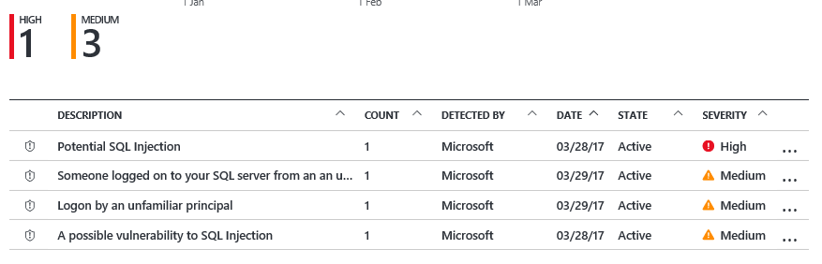



Advanced Threat Detection
Detect unusual and harmful attempts to breach your database
Detects potential SQL injection attacks
Detects unusual access & data exfiltration activities
Actionable alerts to investigate & remediate
View alerts for your entire Azure tenant using Azure Security Center
Attacker
(2) Possible threat to
access / breach data
User
Apps
Azure SQL Database
Developer
Audit Log
Threat Detection
(1) Turn on Threat Detection
(3) Real-time actionable alerts

Slide 19
Backup and Restore
Auto backups and Point in Time Restore (PITR)
  Full Database backup once a week
  Log Backups every 5-10 minutes
  Differential Backups every 12-24 hours
  Backup files on Azure storage with RA-GRS replicated
    Can optionally select LRS or ZRS
  Backup Integrity checks
  Restore to new database
  Long-term retention (up to 10 years) of backups
  Geo-restore of databases if primary region down
  Restore backups of deleted databases
Manual COPY_ONLY Backup/Restore with Managed Instance
Backups retained for 7/35 days
Time
Now
-7 days
Self-service restore to a point in time
DB1
DB1

Slide 20
04
Restrictions

Slide 21

Azure SQL managed instance
Do you need any of these?
Cross database transactions and Linked Servers
Change Data Capture
Database Mail
Resource Governor
Service Broker
SQL Server Agent
SQL Server Auditing
Transactional Replication
Backup and Restore

Slide 22







SQL is everywhere
SQL Server 2019
SQL on Linux
SQL in containers
SQL on Kubernetes
Best for modernizing your databases in your private cloud
Best for a compatible SQL running on Linux
Best for portable, consistent, and easy to patch SQL
Best for database containers at scale with built-in HA
SQL virtual machines
SQL managed instances
SQL databases
SQL Edge
Best for migrations and applications requiring OS-level access
Best for most lift-and-shift migrations to the cloud. Instance pool options are available
Best for modern cloud applications. Elastic pools, Hyperscale and Serverless options are available
Best for data and machine learning applications on IOT Edge

Slide 23
05
How to migrate

Slide 24
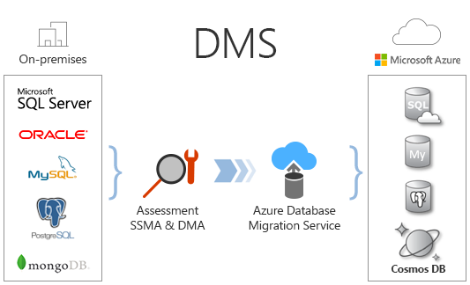

Slide 25
06
DEMO

Slide 26
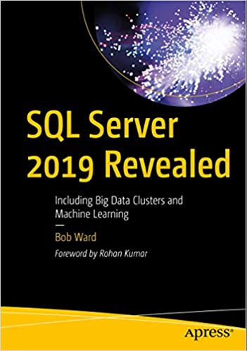
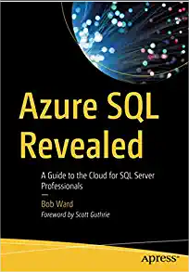


Learn More
Docs SQL: https://docs.microsoft.com/en-us/sql
Series SQL 2019: https://www.youtube.com/playlist?list=PL-_k_UrAvrYugTB6GXpPSs_NMdTVX7XRD
Series Azure SQL: https://youtu.be/Dtr6eRVZQ8I
Microsoft Workshops: https://aka.ms/sqlworkshops
About us

Slide 27
TRILHA – Arquitetura de Dados
Thanks!!!

