Slide 1


SQL Server em Containers

Slide 2


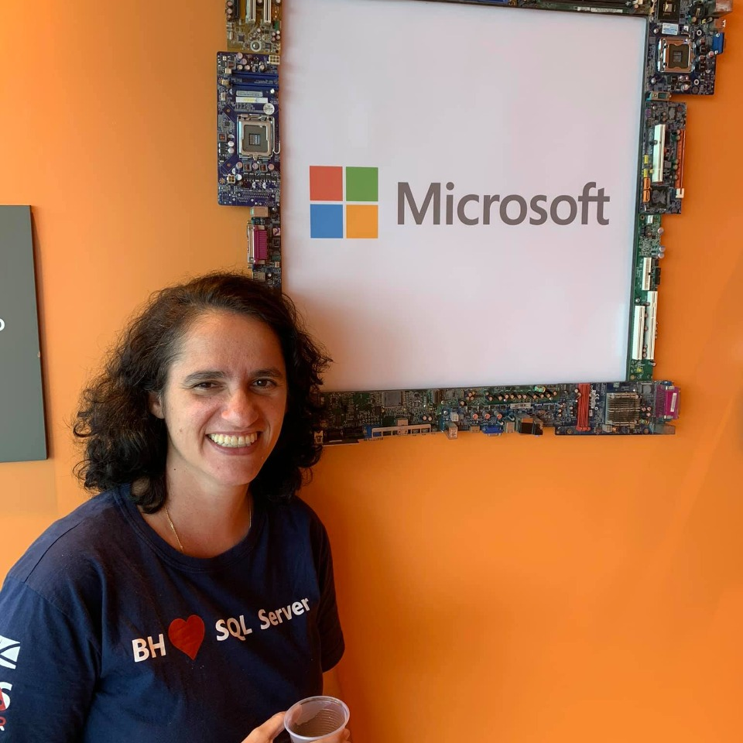

Quem somos
Leonardo Fonseca
MCT | MCSE | DBA
Sulamita Dantas
MVP Data Platform | DBA

Slide 3



Schedule
SQL Server 2019
SQL Server: Linux
SQL Server: Containers

Slide 4

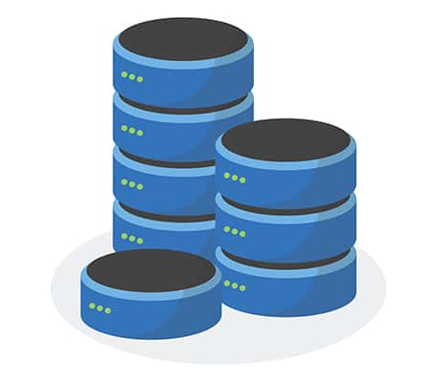
SQL Server
2019

Slide 5






SQL Server 2019
Industry-leading performance and security, with intelligence over all your data
Intelligence over
any data
Choice of platform, language and container
Industry-leading performance and availability
Most secure
over the last 9 years⁶
Insights in minutes
on any device
+
#1 OLTP performance¹
#1 DW performance on 1TB², 3TB³,10TB⁴, and 30TB⁵
Intelligent Database
AI and Machine Learning over all data with the power of SQL and Spark
T-SQL
Java
C/C++
PHP
Node.js
C#/VB.NET
Python
Ruby
The best of Power BI and
SQL Server Reporting Services with Power BI Report Server
In-memory across all workloads
Most consistent data platform
Edge
Private cloud
Public cloud
1/10th the cost of Oracle
All TPC Claims as 11/3/2019.
¹ http://www.tpc.org/4081; ² http://www.tpc.org/3331; ³ http://www.tpc.org/3336 ⁴ http://www.tpc.org/3337 ⁵ http://www.tpc.org/3345 ; ⁶ National Institute of Standards and Technology Comprehensive Vulnerability Database

Slide 6
SQL Server
Linux

Slide 7



SQL Server is the platform of choice
Windows
Linux
  Support for RedHat Enterprise Linux (RHEL), Ubuntu, and SUSE Enterprise Linux (SLES)
  Linux Docker containers
  Kubernetes
  Windows Server / Windows 10
Database and tools compatibility on all platforms
Docker containers and Kubernetes

Slide 8
The Architecture of SQL Server on Linux
System Resource & Latency Sensitive Code
Paths
Everything else
SQLAGENT
SQLSERVR
API
Linux Process (Ring 3)
LibOS (Win API and Kernel)
SQLOS (SQLPAL)
SQL Platform
Abstraction Layer (SQLPAL)
SQL PAL
ABI
Host Extension mapping to OS system calls (IO, Memory, CPU scheduling)
Linux APIs (mmap, pthread_create, ...)
Linux Kernel
Parent “Watchdog” process
Ring 0
fork

Slide 9
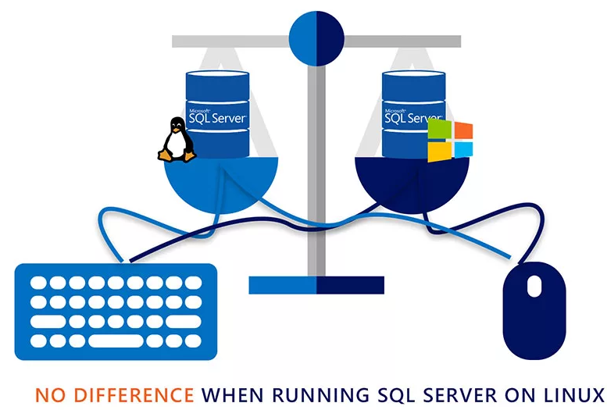
What’s in SQL Server 2019 on Linux
 |  | Windows | Linux
Editions | Developer, Express, Web, Standard, Enterprise |  | 
Services | Database Engine, Integration Services, SQL Server Agent |  | 
 | Analysis Services, Reporting Services, MDS, DQS | 
Mission critical performance and HADR | Maximum number of cores | Unlimited | Unlimited
 | Maximum memory utilized per instance | 24 TB | 12 TB
 | Maximum database size | 524 PB | 524 PB
 | Basic OLTP (Basic In-Memory OLTP, Basic operational analytics) |  | 
 | Advanced OLTP (Advanced In-Memory OLTP, Advanced operational analytics, adaptive query processing) |  | 
 | SQL Server Replication |  | 
 | Basic high availability (2-node single database failover, non-readable secondary) |  | 
 | Advanced HA (Always On - multi-node, multi-db failover, readable secondaries) |  | 
Security | Basic security (Basic auditing, Row-level security, Data masking, Always Encrypted, Active Directory Authentication) |  | 
 | Advanced security (Transparent Data Encryption) |  | 
Data warehousing | PolyBase |  | 
 | Basic data warehousing/data marts (Basic In-Memory ColumnStore, Partitioning, Compression) |  | 
 | Advanced data warehousing (Advanced In-Memory ColumnStore) |  | 
 | Advanced data integration (Fuzzy grouping and look ups) |  | 
Tools | Windows ecosystem: Full-fidelity Management & Dev Tool (SSMS & SSDT), command line tools |  | 
 | Linux/OSX/Windows ecosystem: Dev tools (VS Code), DB Admin GUI tool, command line tools |  | 
Developer | Programmability (T-SQL, CLR, Data Types, JSON, Graph) |  | 
 | Distributed Transactions |  | 
 | Machine Learning Services |  | 

Slide 10

Buying a SQL Server license gives you the option to use it on Windows Server, Linux, or Docker.
Regardless of where you run it —VM, Docker, physical, cloud, on-premises — the licensing model is the same; available features depend on which edition of SQL Server you use.
LICENSE

Slide 11

HADR with SQL Server on Linux
Failover Cluster Instance
Pacemaker and Corosync Single SQL Server instance
SQL resource agent (mssql-server-ha)
Open-source resource agent is available on GitHub Repository¹
Shared Storage
ISCI, NFS, SMB
High Availability Group
CLUSTER_TYPE = EXTERNAL Auto failover
Pacemaker
SQL resource agent (mssql-server-ha)
3 replica required
Configuration only replica for metadata
Full AG capabilities
Read-Scale Availability Group
CLUSTER_TYPE = NONE
No clustering required
Manual or forced failover
Sync or async replicas
Read scale routing
Cross-platform
Industry-leading solutions available from HA/DR partners²

Slide 12
SQL Server
Containers

Slide 13


Why Containers?
Portable
Run anywhere Docker is supported
Lightweight
Reduced disk, CPU, and memory footprint
Consistent
Consistent image of SQL Server, scripts, and tools
Efficient
Faster deployment, reduced patching, and
less downtime
Container configuration
Persisted storage
Database
Switch for
simple upgrades
Container
Container
Container
sqlservr
sqlservr
sqlservr
Bins/libs
Bins/libs
Bins/libs
Docker
Host OS
Infrastructure

Slide 14
SQL Server - Shared storage HA in Kubernetes
Built-in HADR orchestration with no clustering required
Kubernetes
Node
Node
Node
Pod
Load Balancer Service
Pod
SQL Server
SQL Server
User
Pod
SQL Server
Persistent Volume Storage

Slide 15



Demo
Can SQL Server Docker?

Slide 16

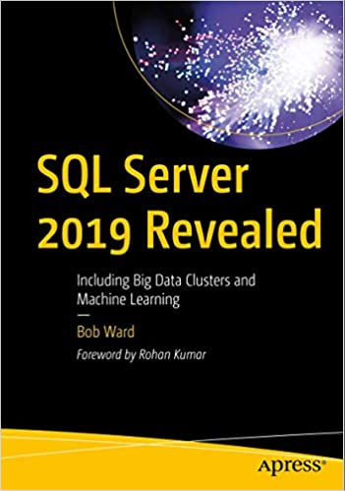
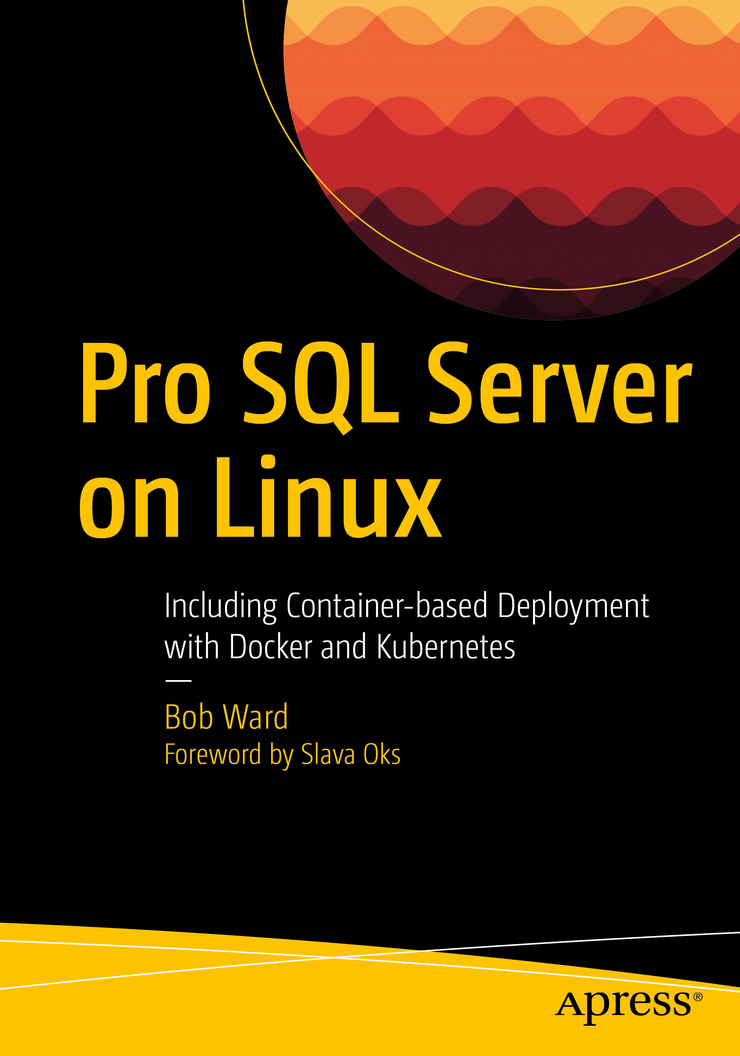

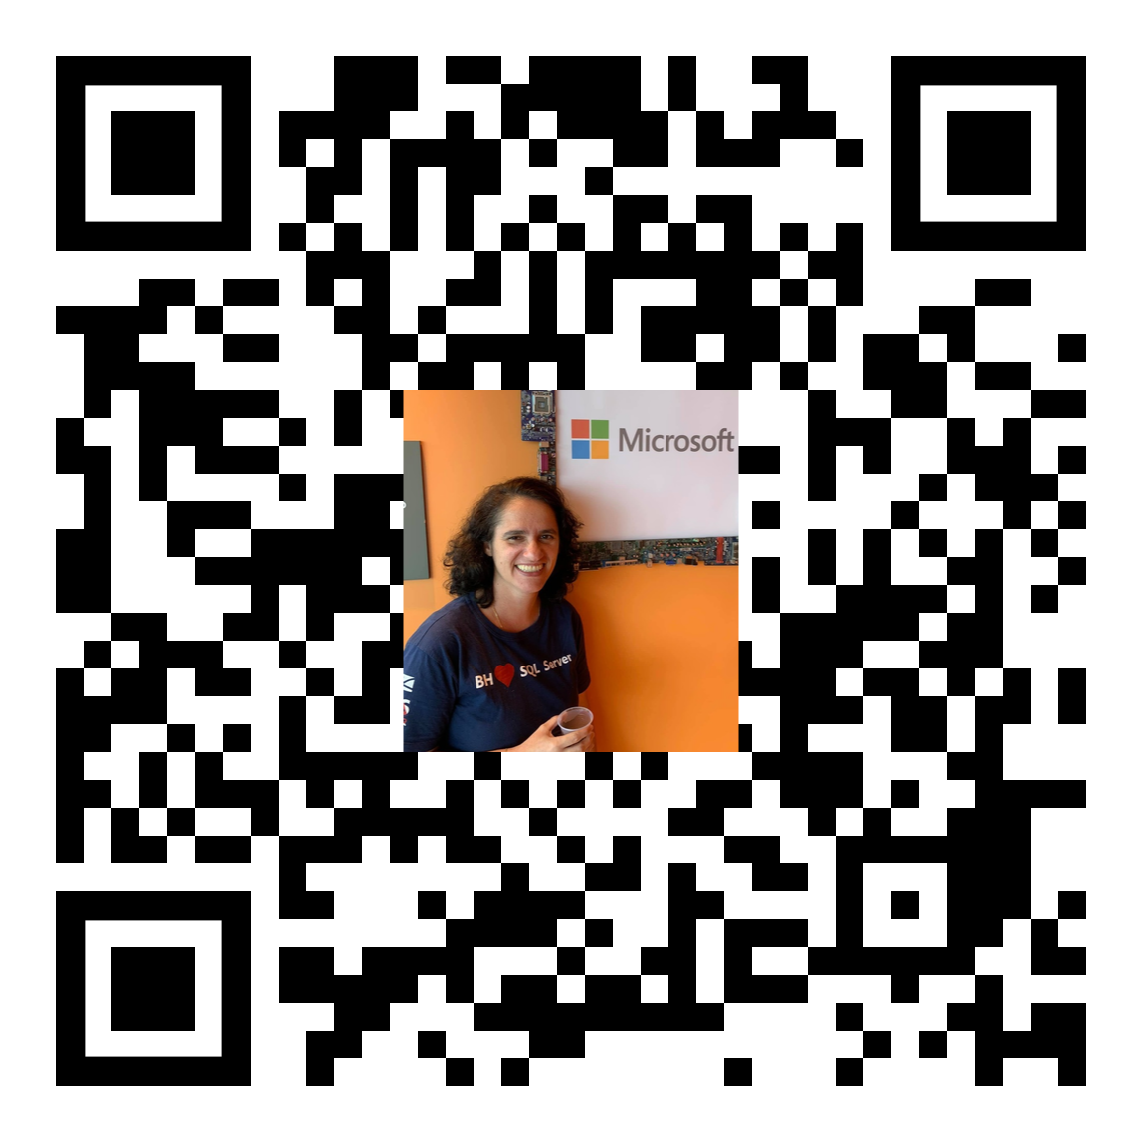
Learn More
Workshop SQL 2019: https://aka.ms/sqlworkshops
Download and try it at: http://aka.ms/ss19
What’s new for SQL 2019: https://docs.microsoft.com/en-us/sql/sql-server/what-s-new-in-sql-server-ver15?
Site SQL Server 2019: https://www.microsoft.com/en-us/sql-server/sql-server-2019
Learning Series: https://www.youtube.com/playlist?list=PL-_k_UrAvrYugTB6GXpPSs_NMdTVX7XRD
About us

Slide 17
Obrigado!

