Slide 1
TRILHA – Cloud
Como reduzir custos do seu banco SQL em Cloud

Slide 2

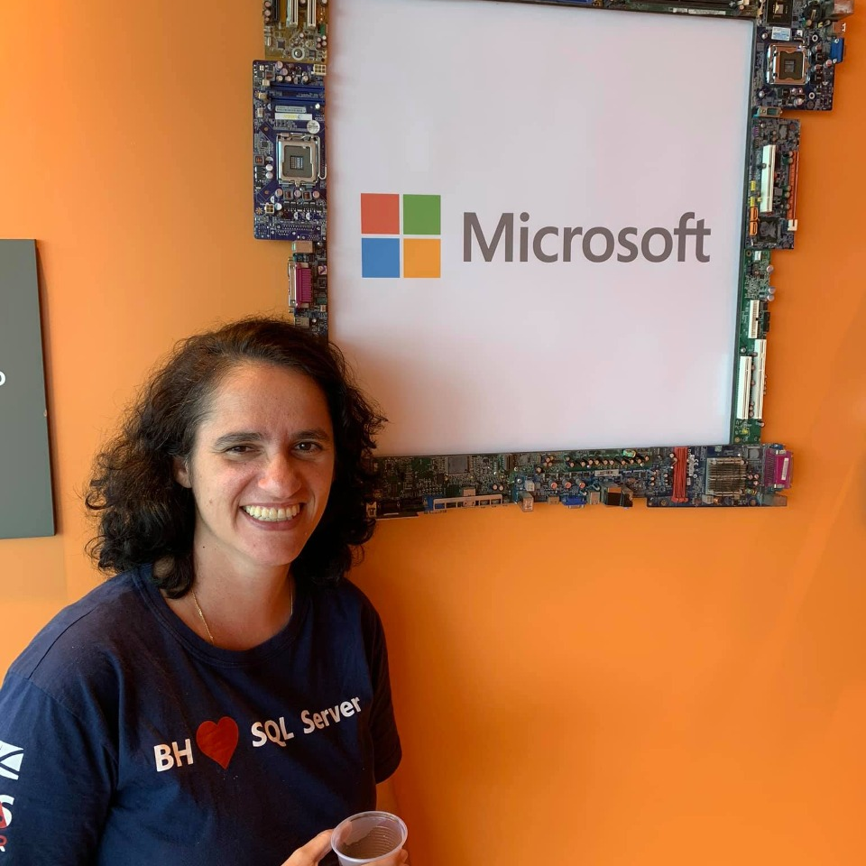


TRILHA – Cloud
Quem somos:
Leonardo Fonseca & Sulamita Dantas

Slide 3
Cloud Concepts
Azure SQL
Demo

Slide 4
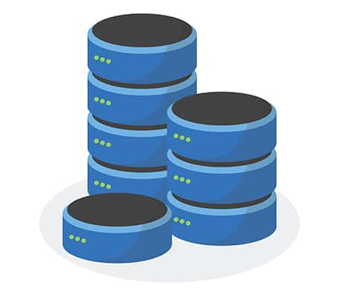
01
Cloud Concepts

Slide 5
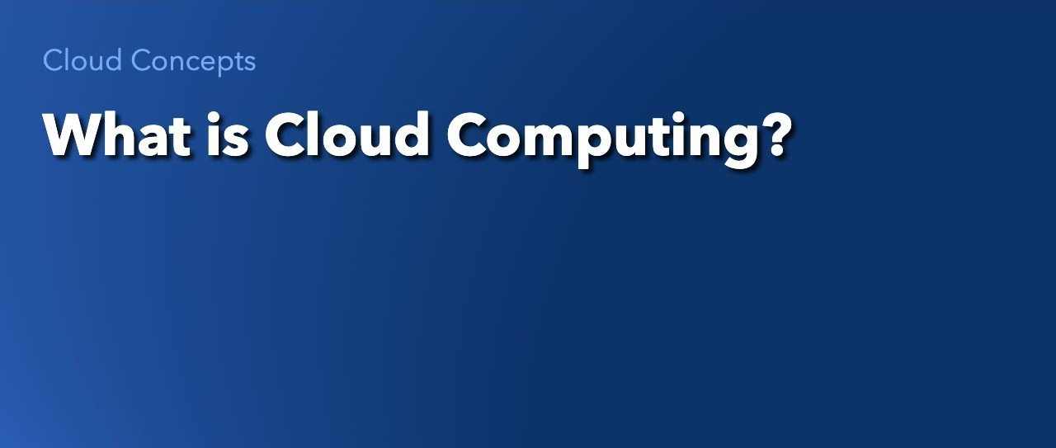

Slide 6
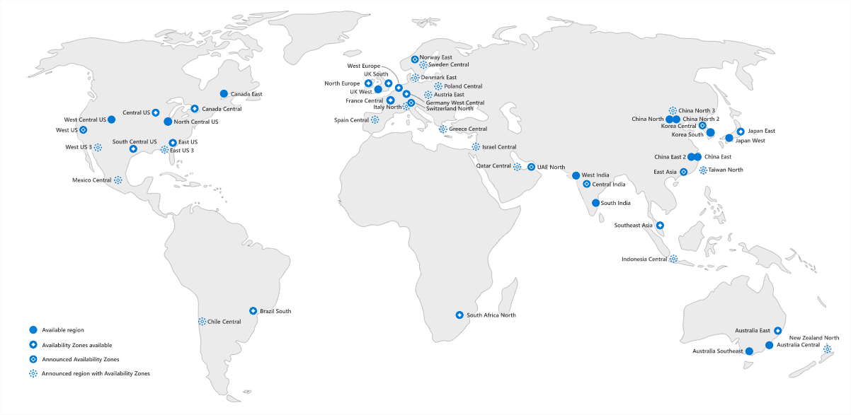

Slide 7
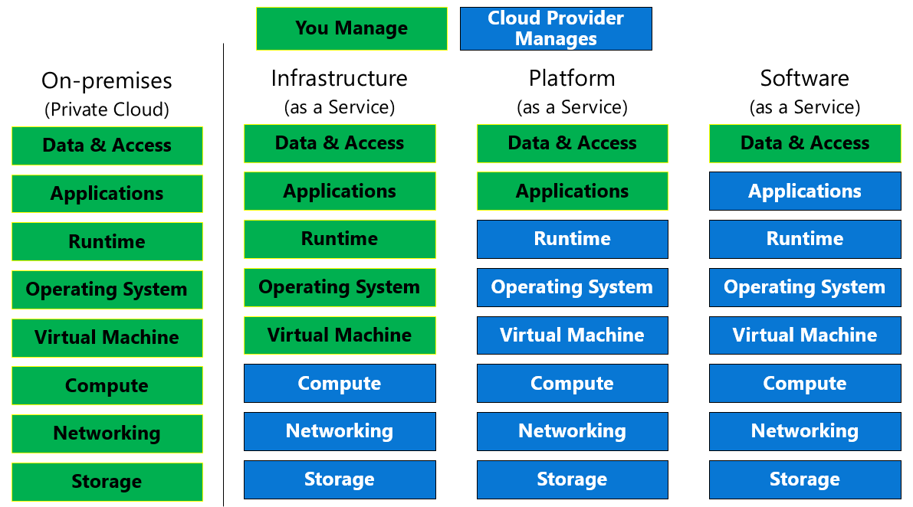

Slide 8
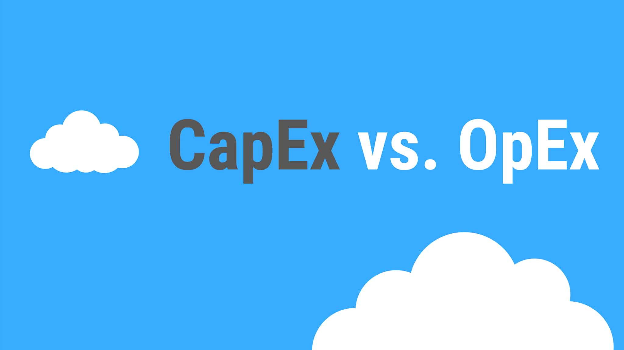

Slide 9
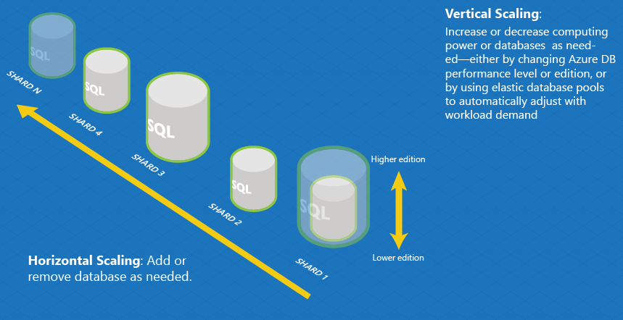
Elasticity VS Scalability

Slide 10
02
Azure SQL

Slide 11
Why Azure SQL Database?
Automatic backups
Advanced security, threat detection, TDE by default
Ease of HADR (readable secondaries, geo-replication)
Familiar SQL Server ecosystem and mindshare
Latest code base and features
Automatic patching, upgrades
Quickly provision up or down
Query store on by default

Slide 12





Azure SQL
SQL virtual machines
Managed instances
Databases
Best for migrations and applications requiring OS-level access
Best for modern cloud applications. Hyperscale and serverless options are available
SQL virtual machine
Single instance
Instance pool
Single database
Elastic pool
  SQL Server and OS server access
  Expansive SQL And OS version support
  Automated manageability features for SQL Server
  SQL Server surface area (vast majority)
  Native virtual network support
  Fully managed service
  Pre-provision compute resources for migration
  Enables cost-efficient migration.
  Ability to host smaller instances (2Vcore)
  Currently in public preview
  Hyperscale storage (up to 100TB)
  Serverless compute
  Fully managed service
  Resource sharing between multiple databases to price optimize
  Simplified performance management for multiple databases
  Fully managed service

Slide 13
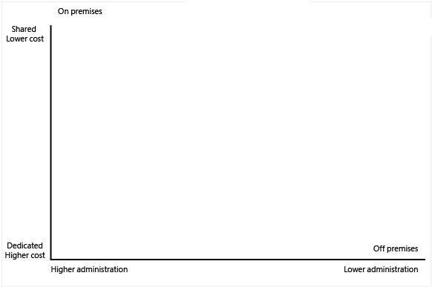

Slide 14
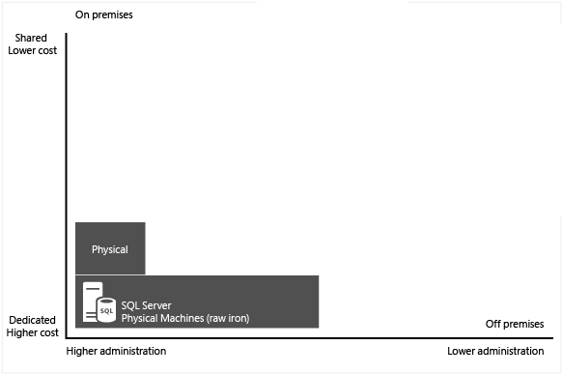

Slide 15
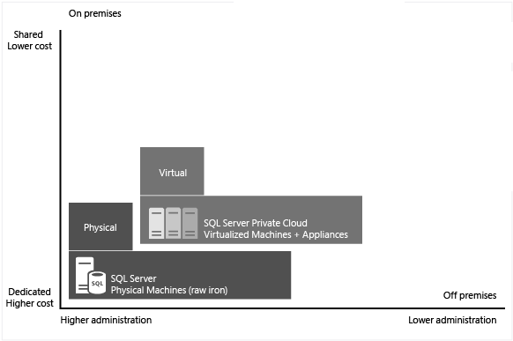

Slide 16
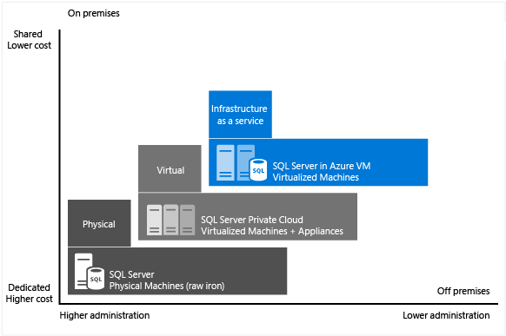

Slide 17
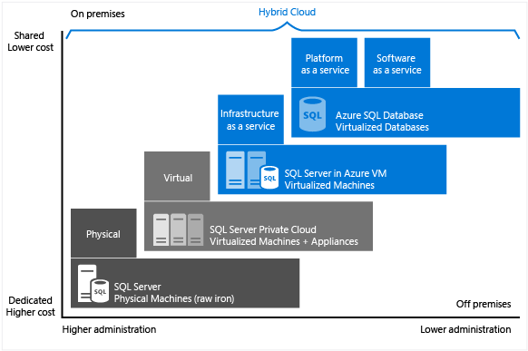

Slide 18
Purchasing models - SQL Database
DTU model
Simple, preconfigured
vCore model
Independent scalability
Compute
Compute
Microsoft’s recommendation
Storage
Storage
  Pre-packaged, bundled unit that represents the database power
  Designed for predictable performance, but somewhat inflexible and limited in options
  DTU sizing offers simplicity of choice
This model allows you to independently choose compute and storage resources. It also allows you to use Azure Hybrid Benefit for SQL Server and Reserved Capacity to gain cost savings.
Best for customers who value flexibility, control and transparency

Slide 19
DTU-based purchasing option and service tiers
Choose a blend of compute, memory, and I/O resources to support light to heavy database workloads
Basic for less demanding workloads
Standard for workloads with a range of performance requirements
Premium for IO-intensive workloads

Slide 20
vCore purchasing option and service tiers
Choose the number of vCores, compute generation, storage size
General Purpose for budget oriented balanced compute and storage
Business Critical for high transaction rate and low IO latency. Fast failovers using multiple replicas. Free-of-charge read-only replica. RPO 5 sec, RTO 30 sec.
Hyperscale for auto-scaling storage size up to 100 TB, compute scaling and fast database restore.
Provisioned vs. Serverless

Slide 21
Azure SQL: vCore Service Tiers
Service tier | General purpose |  | Business critical |  | Hyperscale
Best for | Most budget-oriented workloads |  | Critical business applications with high IO requirements. |  | OLTP and HTAP workloads with highly scalable storage and read-scale requirements
Deployment option | Single / Elastic Pools | Managed Instance | Single / Elastic Pools | Managed Instance | Single
Compute tiers | Gen4: 1 to 24 vCore Gen5: 2 to 80 vCore Serverless: 1 to 16 vCore | Gen4: 4 to 24 vCore Gen5: 4 to 80 vCore | Gen4: 1 to 24 vCore Gen5: 2 to 80 vCore | Gen4: 4 to 24 vCore Gen5: 4 to 80 vCore | Gen4: 1 to 24 vCore Gen5: 2 to 80 vCore
Storage | Remote SSD based Premium storage |  | Local SSD |  | Local SSD Cache, remote Page servers with local SSD ( RBPEX)
 | 32GB – 4TB per instance | 32GB – 8TB per instance | 32GB – 4TB per instance | 32GB – 4TB per instance | Scale from 10GB to 100TB of storage in 1GB increments
In-Memory | Not supported |  | Supported |  | Not supported
Read-write IO | 7000 IOPS 5-10ms for data access |  | 200K IOPS 1-2ms for all data access |  | RBPEX: 200K IOPS,1-2ms for hot data access Remote reads: >2ms
Log throughput | 1.875 MB/s per Vcore (Max 30MB/sec) |  | 6 MB/s per Vcore (Max 96MB/sec) |  | 100MBPS
Read Replicas | 0 read replicas |  | 3 replicas, 1 read-scale replica, zone-redundant HA |  | Primary read/write replica + up to 4 read replicas
Backups | RA-GRS, 7-35 days (7 days by default) |  | RA-GRS, 7-35 days (7 days by default) |  | LRS, ZRS, RA-GRS, 7 days

Slide 22
Azure SQL Database Availability SLAs
Highest availability SLA in the industry, leveraging availability zones
Differentiated SLA for Hyperscale based on # of replicas
Only business continuity SLA in the industry, RTO & RPO, 100% service credit
Database uptime in a region + guaranteed recovery during disasters = mission critical fault resilience
SLA category |  | service tier | sla | Maximum service credit
Availability |  | Hyperscale w/ 0 replicas | 99.9% uptime | 100%
 |  | Hyperscale w/ 1 replica | 99.95% uptime | 100%
 |  | Hyperscale w/ 2+ replica | 99.99% uptime | 100%
 |  | General purpose | 99.99% uptime | 100%
 |  | Business critical (zone redundant) | 99.995% uptime | 100%
Business continuity | Recovery point objective (RPO) | All | 5 sec | 100%
 | Recovery Time Objective (RTO) | Single database | 30 sec | 100%
For more info see https://azure.microsoft.com/en-us/blog/understanding-and-leveraging-azure-sql-database-sla/

Slide 23
03
DEMO

Slide 24
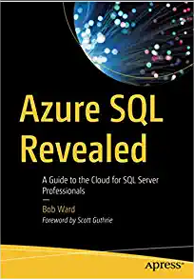
Learn More
Docs SQL: https://docs.microsoft.com/en-us/sql
Series Azure SQL: https://youtu.be/Dtr6eRVZQ8I
Microsoft Workshops: https://aka.ms/sqlworkshops
About us

Slide 25
TRILHA – Arquitetura de Dados
Thanks!!!

